Slide 1
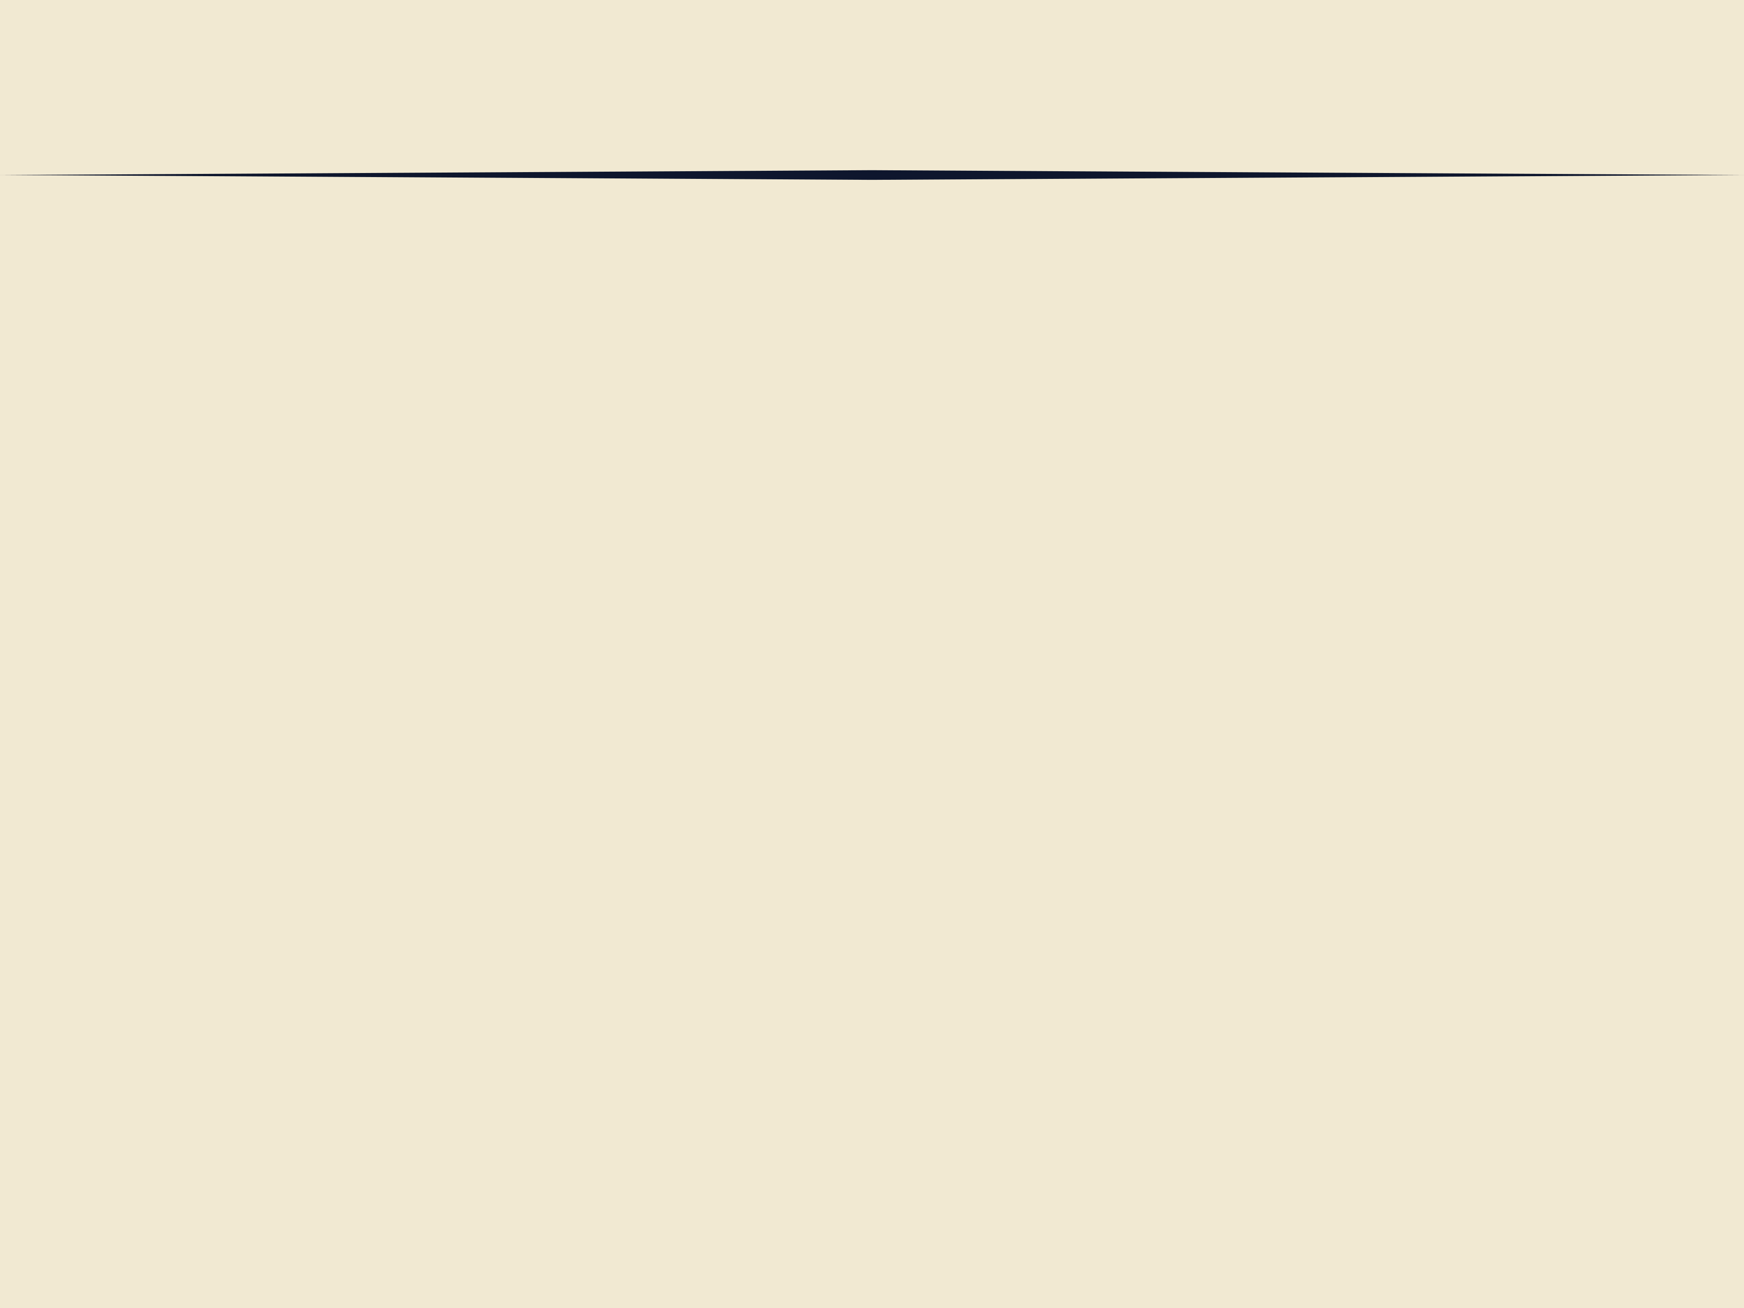
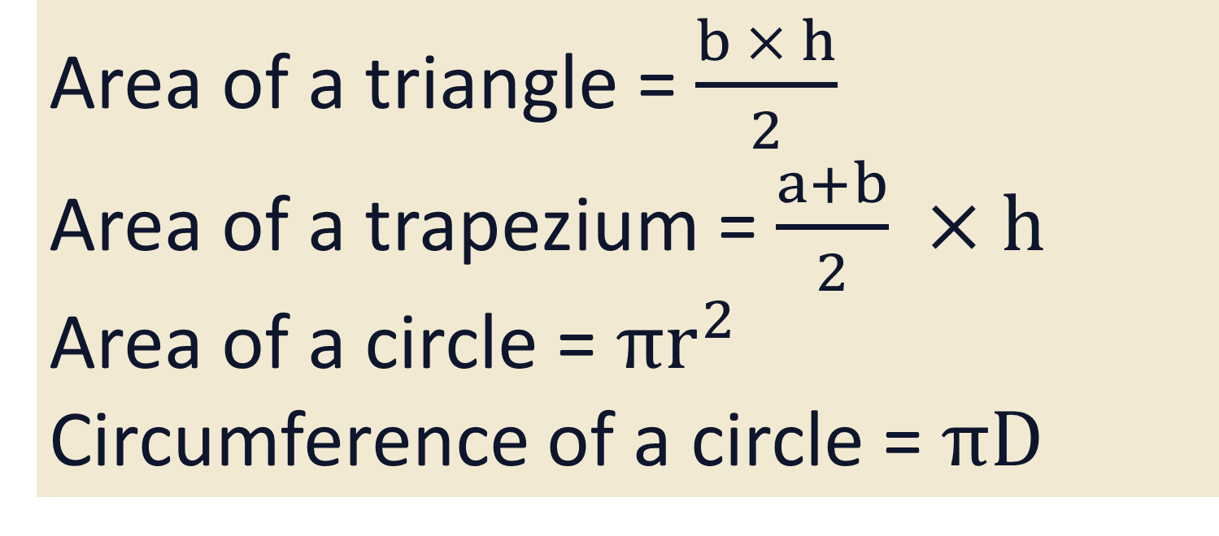
Formulae
Area of a triangle = $\frac{b × h}{2}$
Area of a trapezium = $\frac{a+b}{2} ×h$
Area of a circle = $πr^{2}$
Circumference of a circle = $πD$

Slide 2
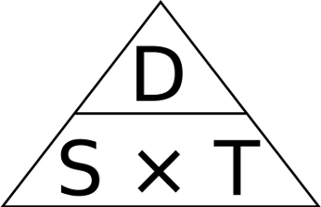
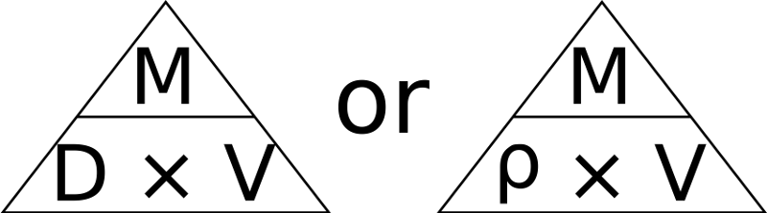
Formulae
Formula triangle for speed:
Formula triangle for density:

Slide 3
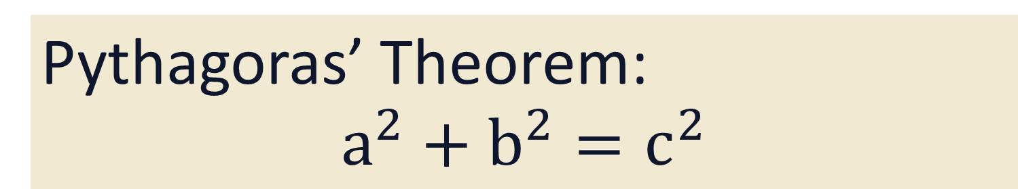
Formulae
Pythagoras’ Theorem:
$$a^{2}+b^{2}=c^{2}$$

Slide 4
SUVAT
S = Displacement
U = Initial Velocity
V = Final Velocity
A = Acceleration
T = Time

Slide 5
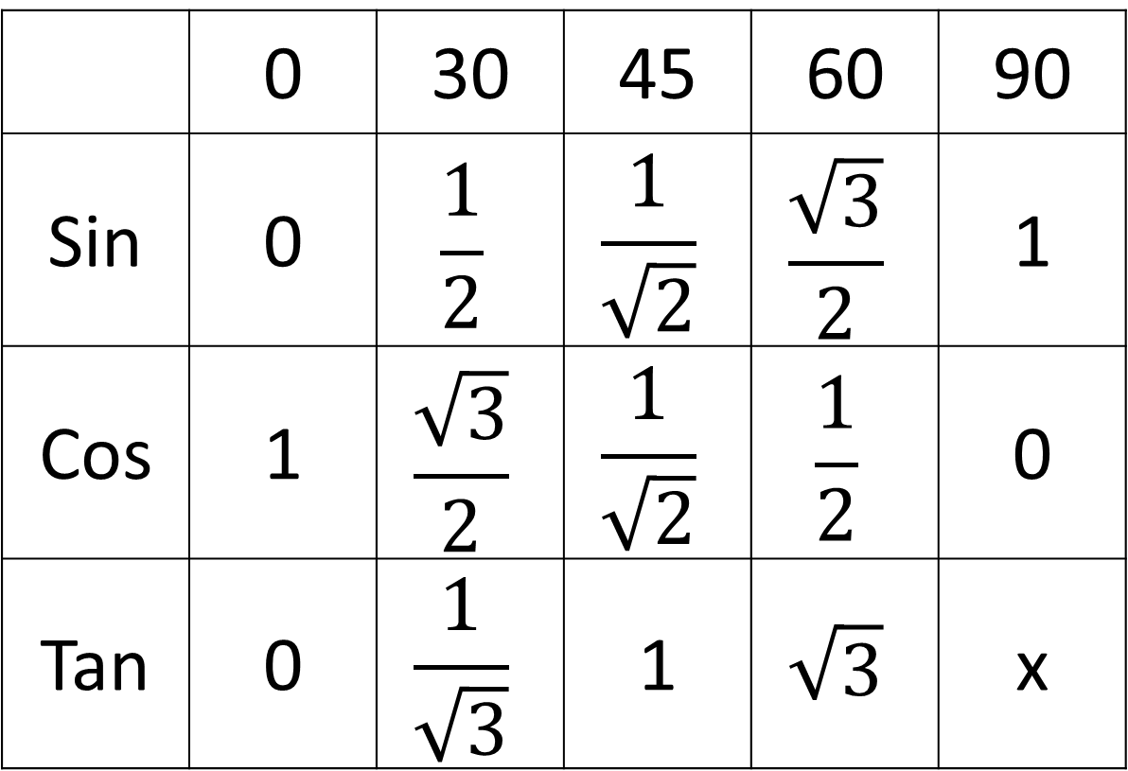
Exact Trig Values
 | 0 | 30 | 45 | 60 | 90
Sin | 0 | $$\frac{1}{2}$$ | $$\frac{1}{\sqrt{2}}$$ | $$\frac{\sqrt{3}}{2}$$ | 1
Cos | 1 | $$\frac{\sqrt{3}}{2}$$ | $$\frac{1}{\sqrt{2}}$$ | $$\frac{1}{2}$$ | 0
Tan | 0 | $$\frac{1}{\sqrt{3}}$$ | 1 | $$\sqrt{3}$$ | x

Slide 6
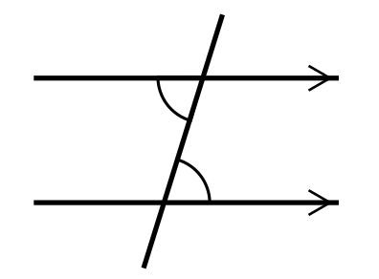
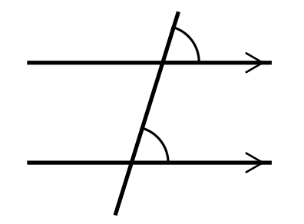
Angle Facts
Alternate angles are equal
Corresponding angles are equal

Slide 7
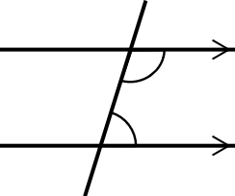
Angle Facts
Co-interior angles sum to 180°

Slide 8
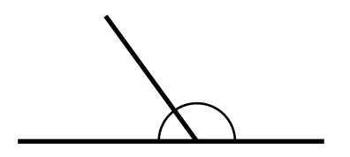
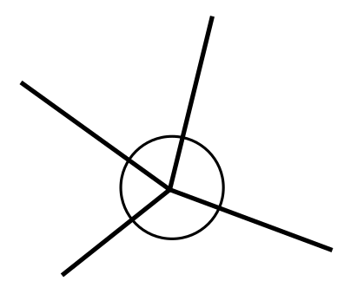
Angle Facts
Angles on a straight line add up to 180°
Angles around a point add up to 360°

Slide 9
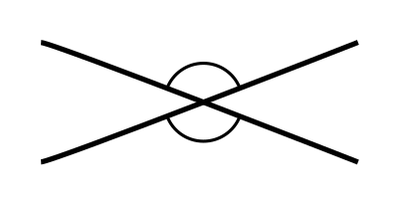
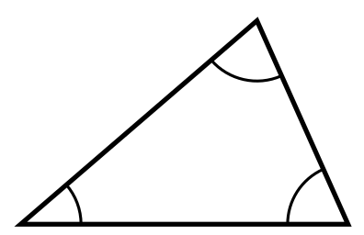
Angle Facts
Opposite angles are equal
Angles in a triangle add up to 180°

Slide 10
Formulae
Foundation notes end here.
Higher and intermediate continue

Slide 11
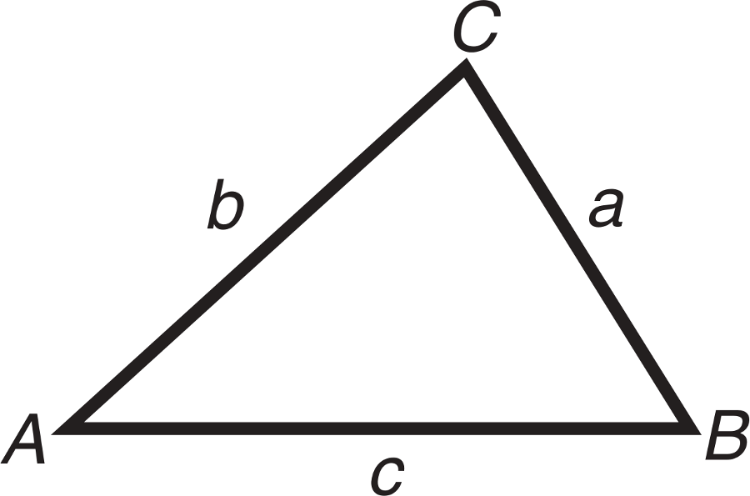
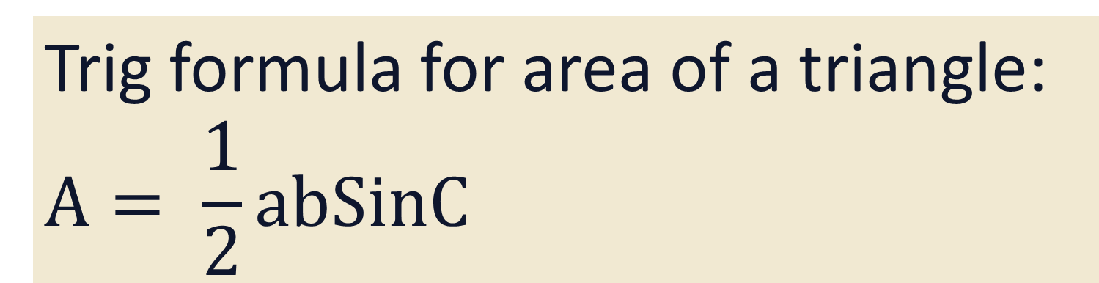
Formulae
Trig formula for area of a triangle:
$$A= \frac{1}{2}abSinC$$

Slide 12
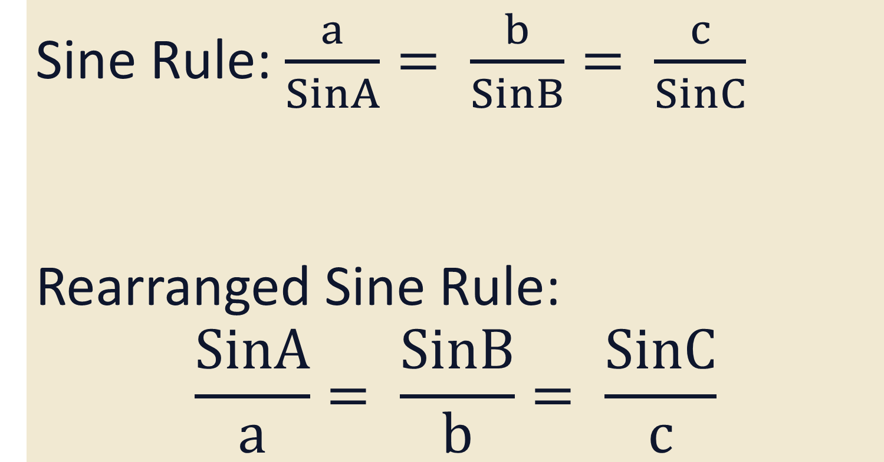
Formulae
Sine Rule: $\frac{a}{SinA}= \frac{b}{SinB}= \frac{c}{SinC}$
Rearranged Sine Rule:
$$\frac{SinA}{a}= \frac{SinB}{b}= \frac{SinC}{c}$$

Slide 13
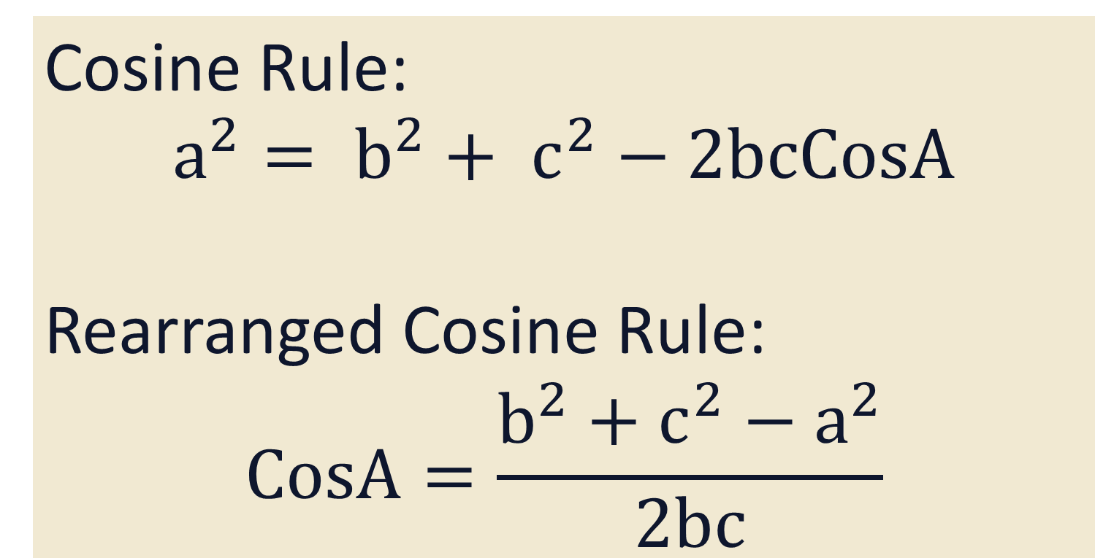
Formulae
Cosine Rule:
$$a^{2}= b^{2}+ c^{2}−2bcCosA$$
Rearranged Cosine Rule:
$$CosA=\frac{b^{2}+c^{2}−a^{2}}{2bc}$$

Slide 14
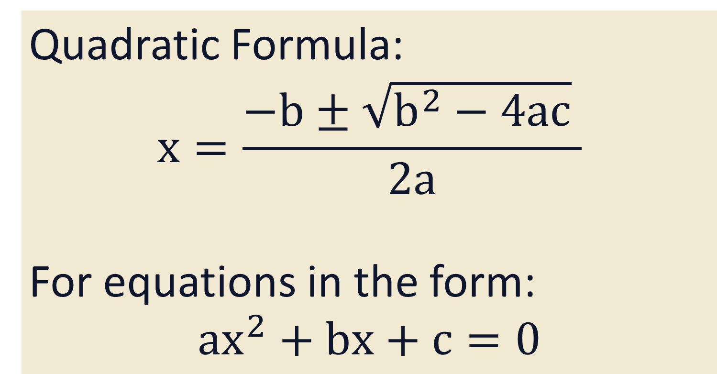
Formulae
Quadratic Formula:
$$x=\frac{−b±\sqrt{b^{2}−4ac} }{2a}$$
For equations in the form:
$${ax}^{2}+bx+c=0$$

Slide 15
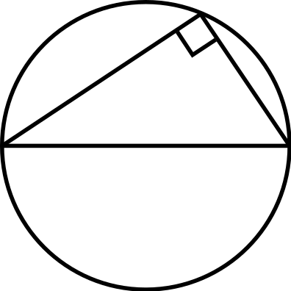
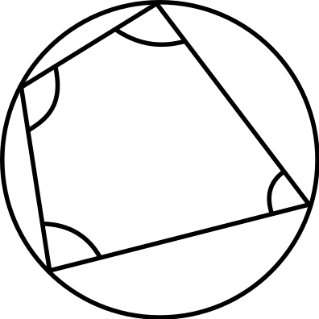
Circle Theorems
Angle in a semi-circle is 90°
Opposite angles in a cyclic quadrilateral sum to 180°

Slide 16

Circle Theorems
Angle at the centre is twice the angle at the circumference
Do other two versions

Slide 17
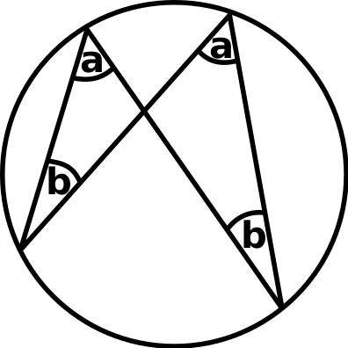
Circle Theorems
Angles in the same segment are equal

Slide 18
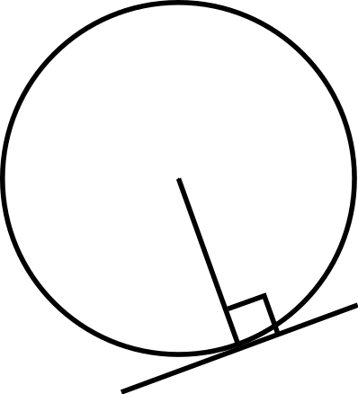
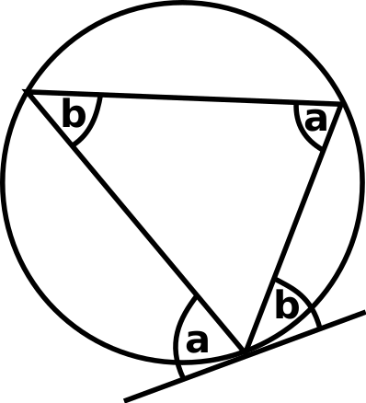
Circle Theorems
Angle between a radius and a tangent is 90°
Alternate segment theorem

Slide 19
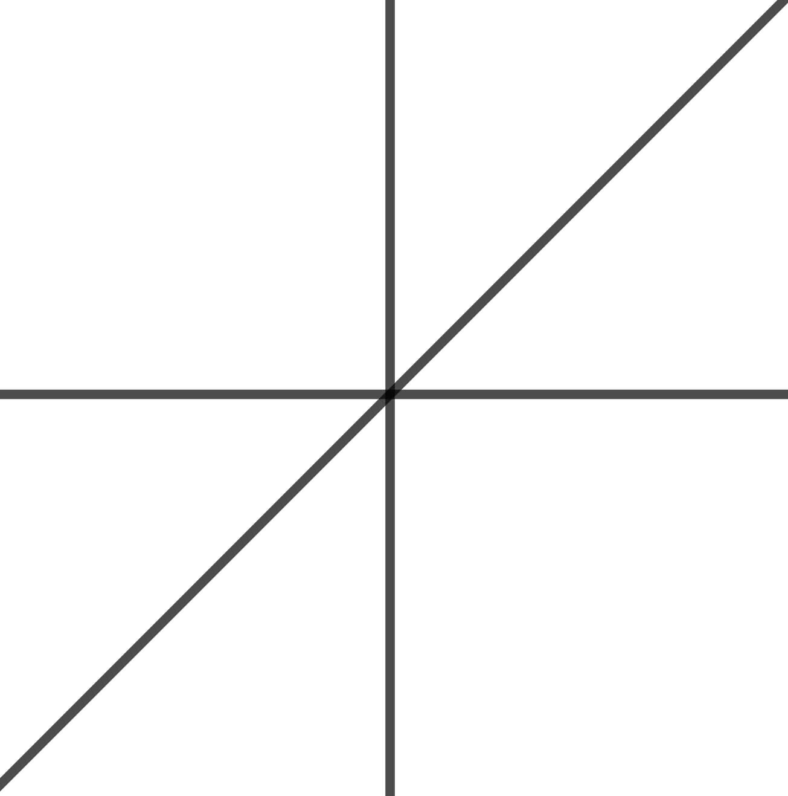
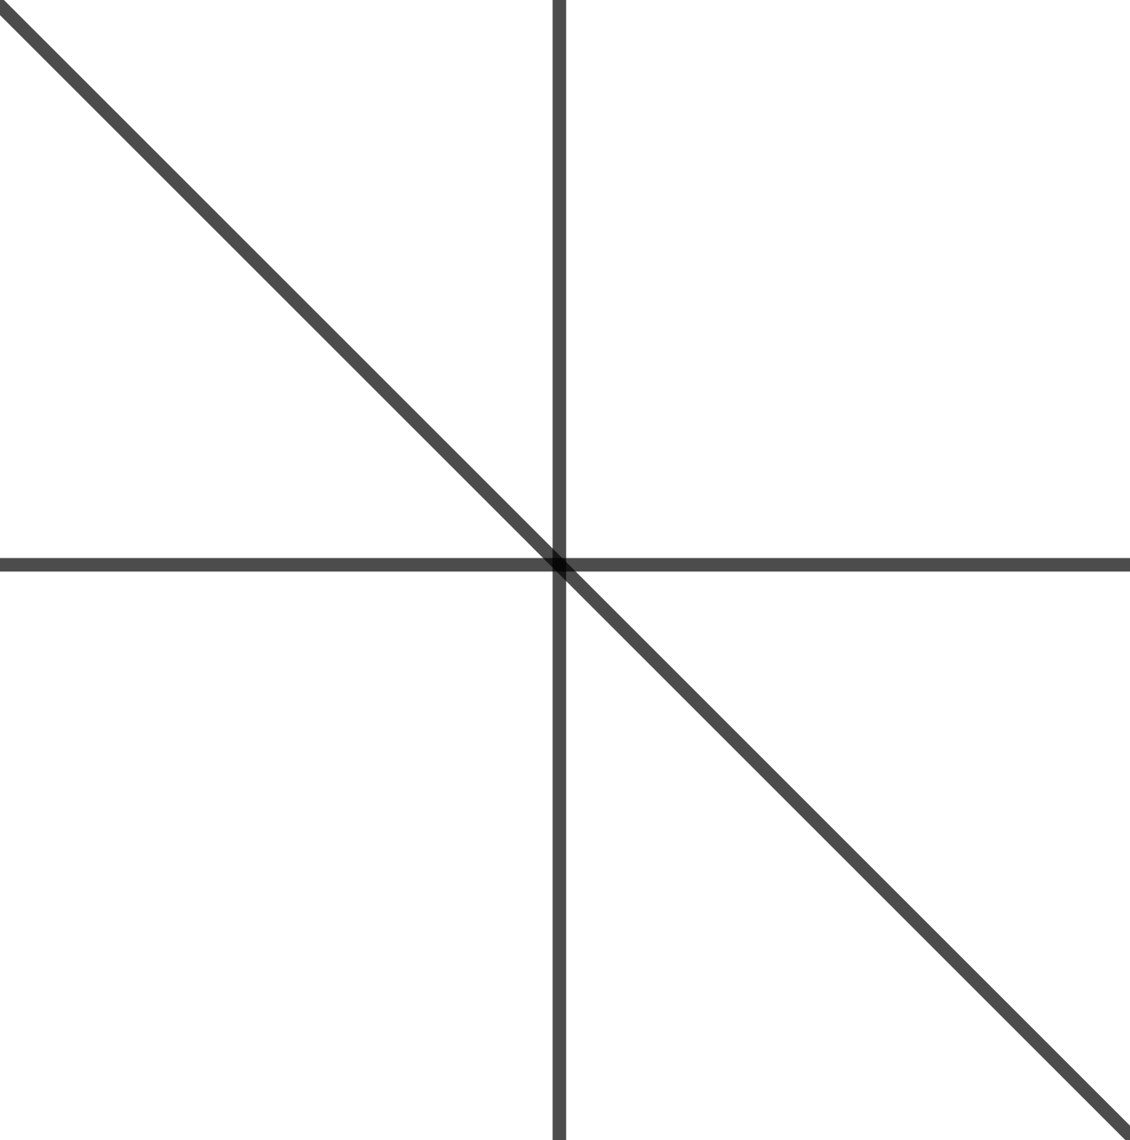


Graphs
$$y=x$$
$$y=− x$$

Slide 20
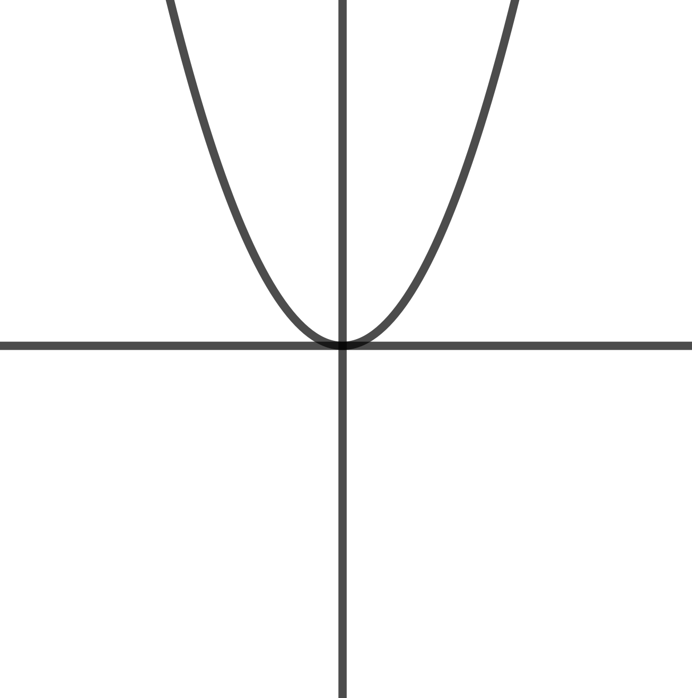
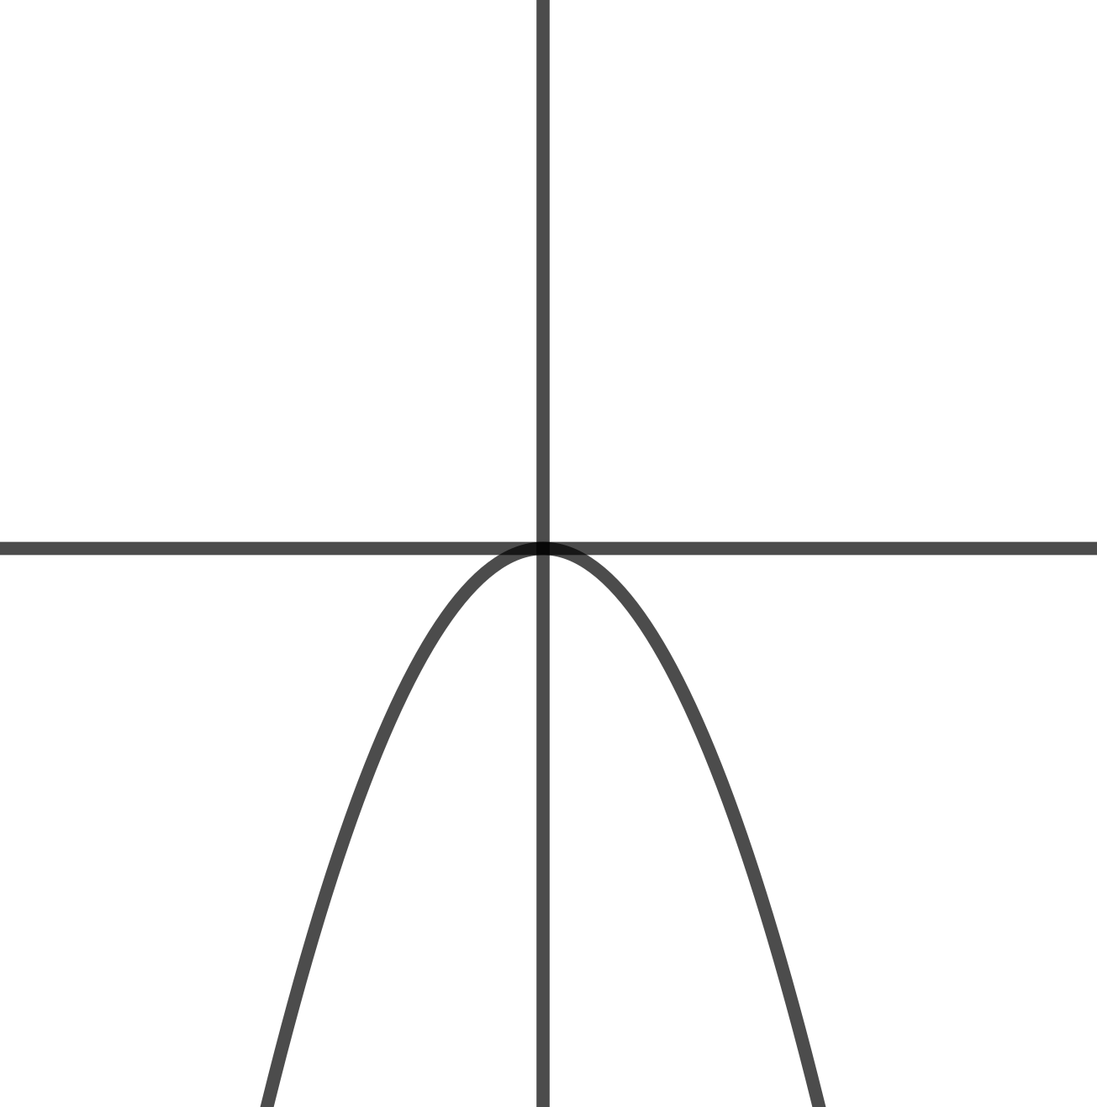


Graphs
$$y=x^{2}$$
$$y=− x^{2}$$

Slide 21
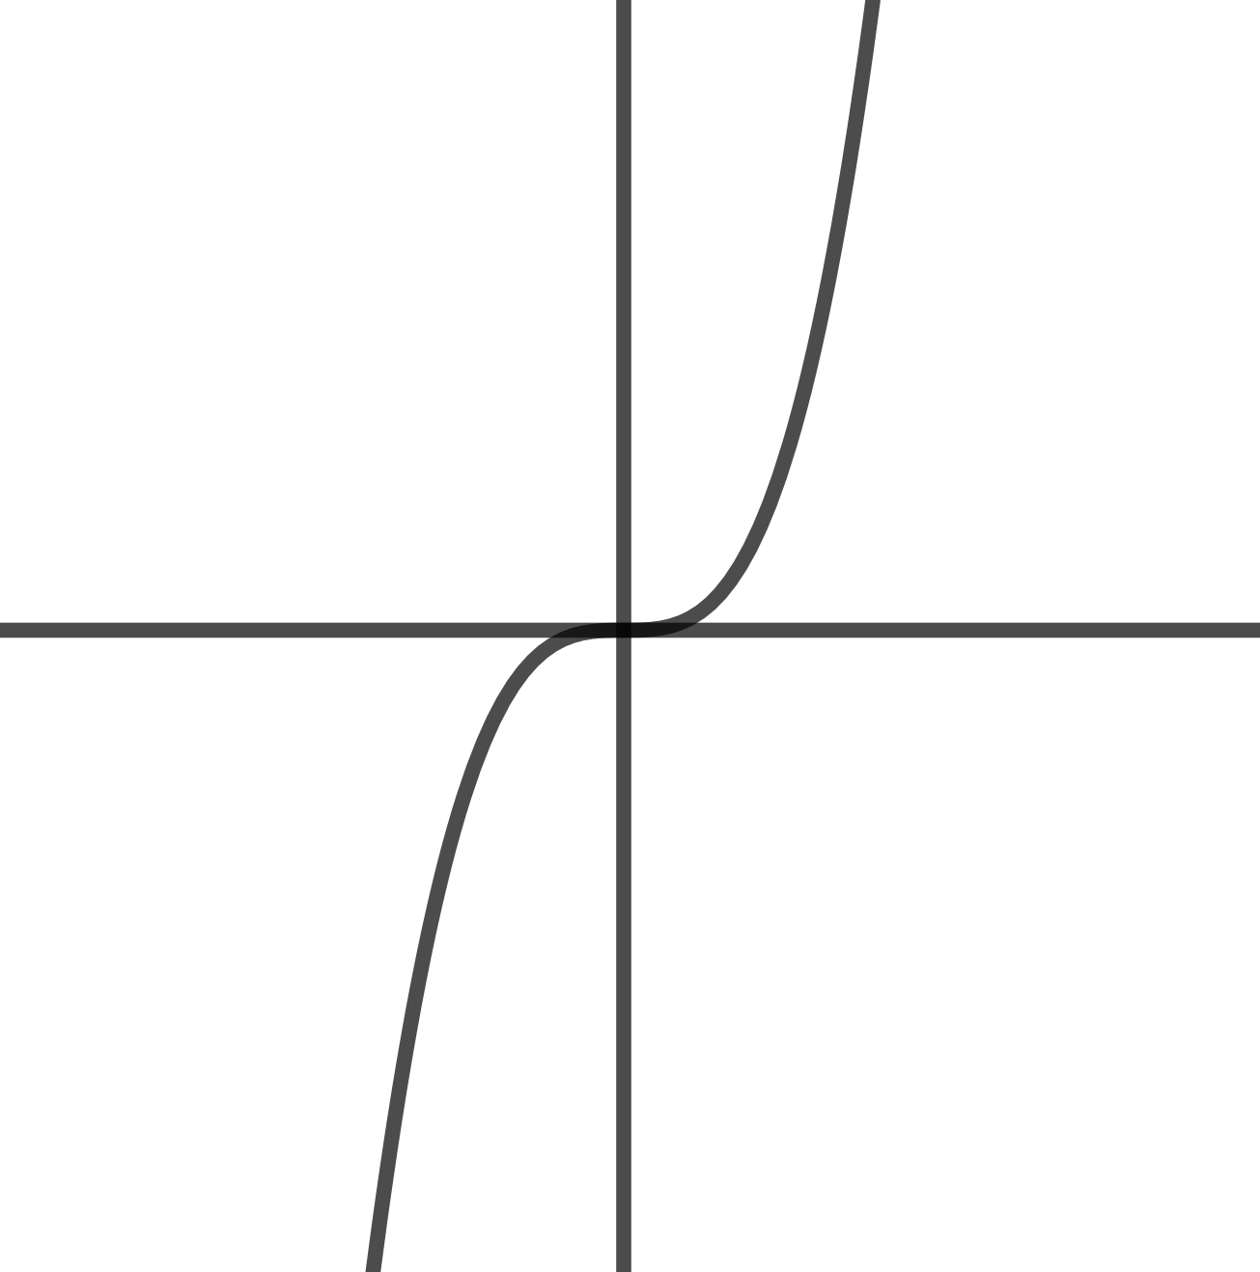
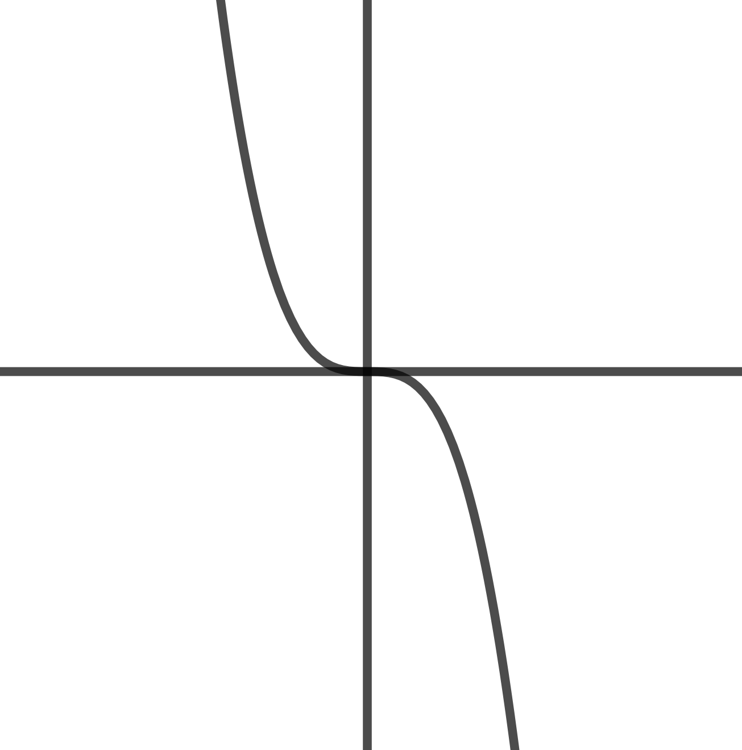


Graphs
$$y=x^{3}$$
$$y=− x^{3}$$

Slide 22
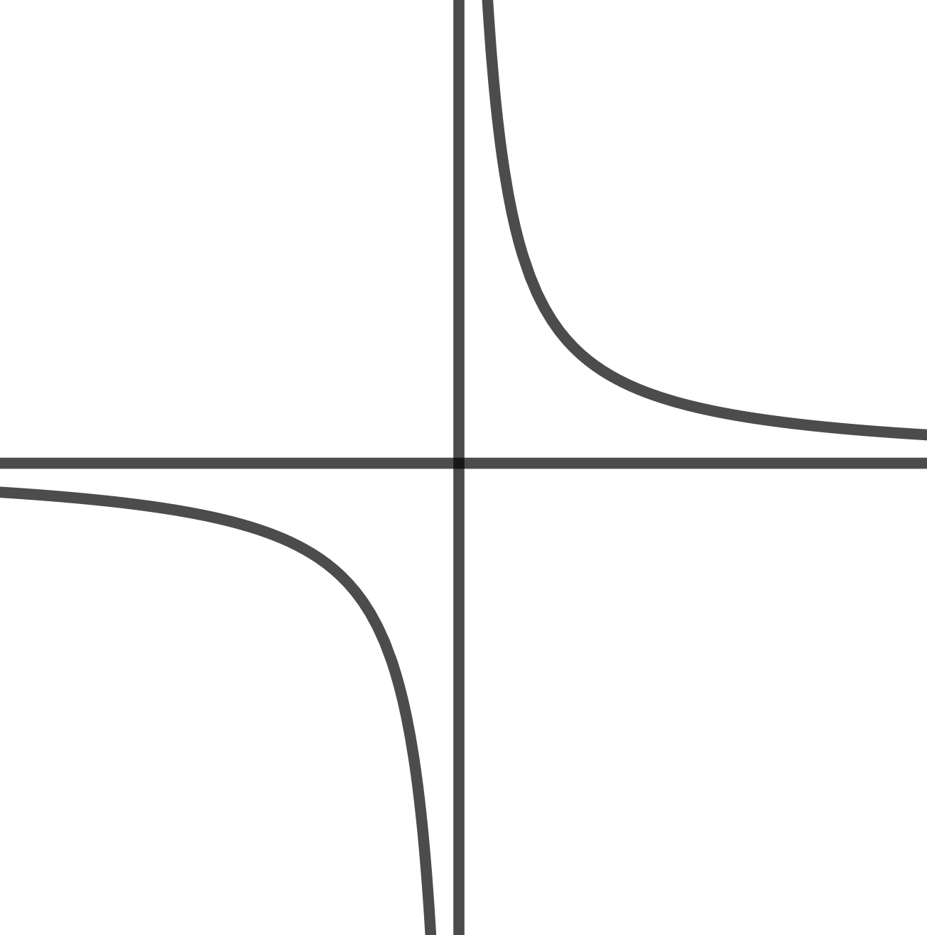
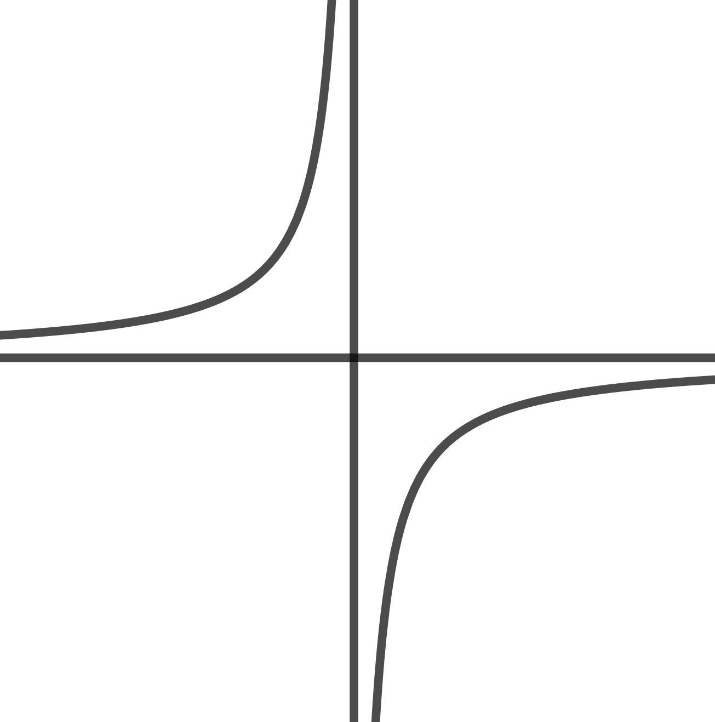
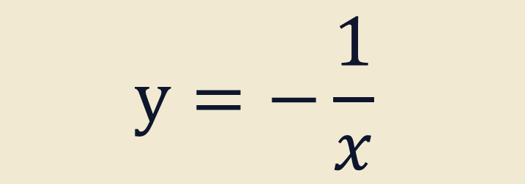
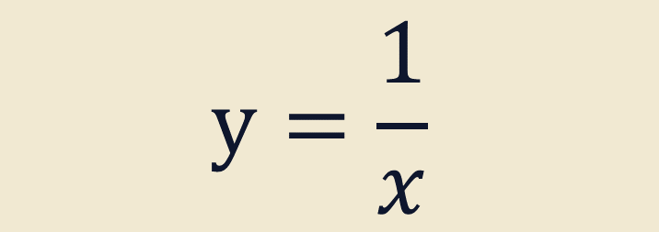
Graphs
$$y=\frac{1}{x}$$
$$y=−\frac{1}{x}$$

Slide 23
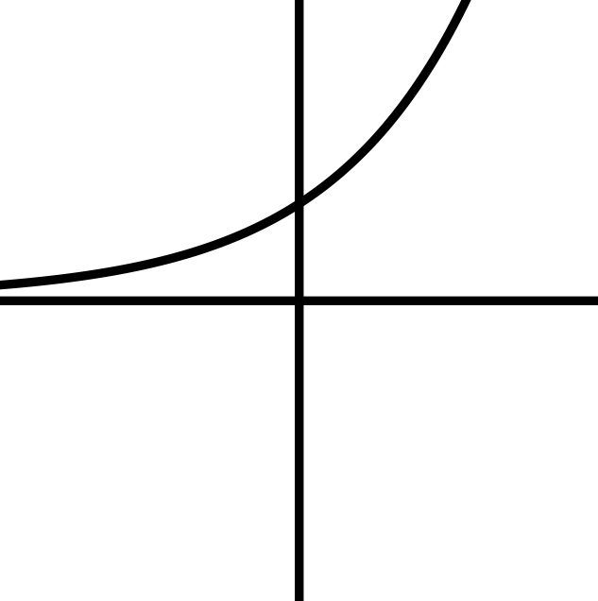
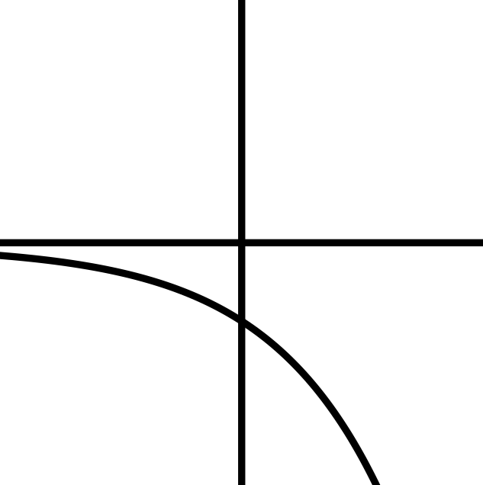


Graphs
$$y=n^{x}$$
$$y=−n^{x}$$

Slide 24
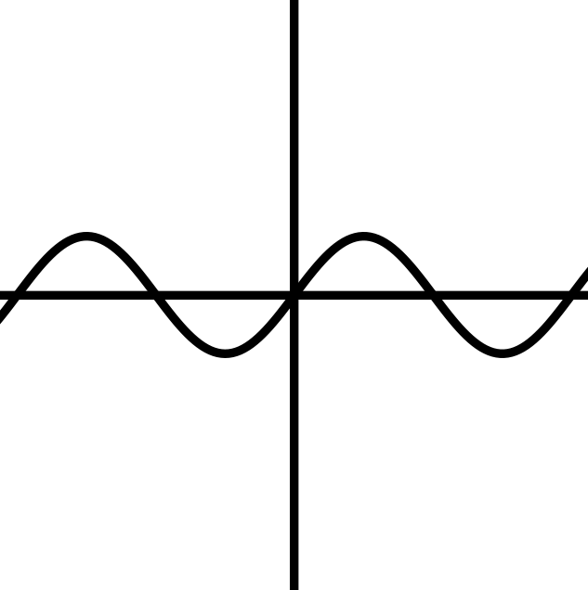
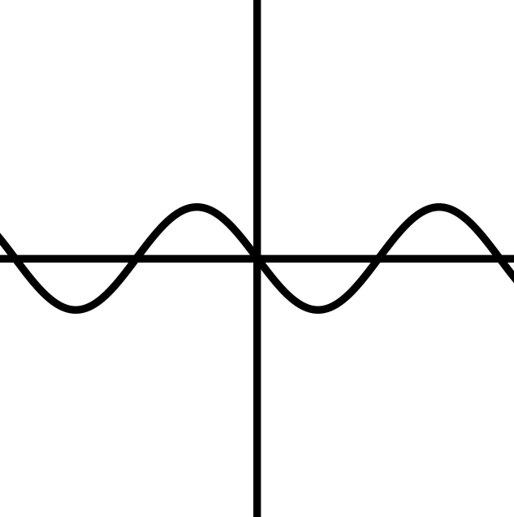

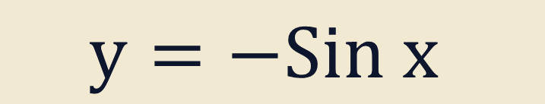
Graphs
$$y=Sin x$$
$$y=−Sin x$$

Slide 25
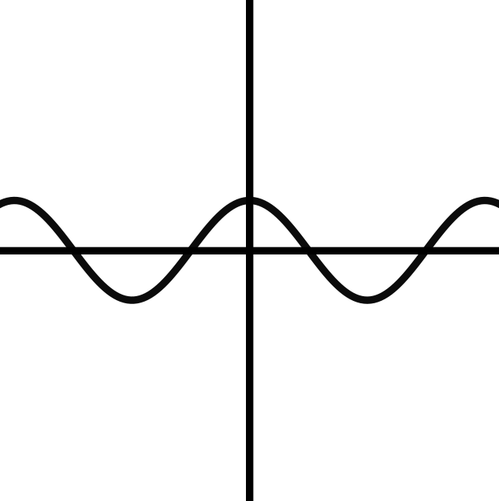
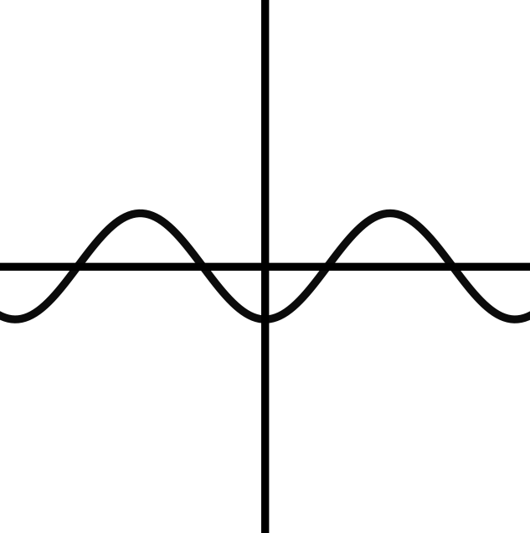

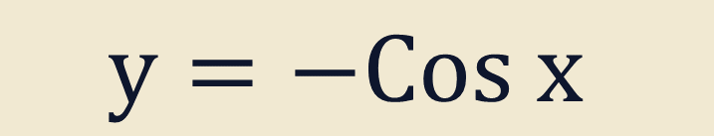
Graphs
$$y=Cos x$$
$$y=−Cos x$$

Slide 26
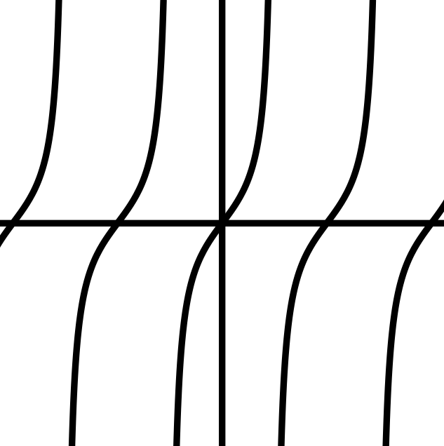
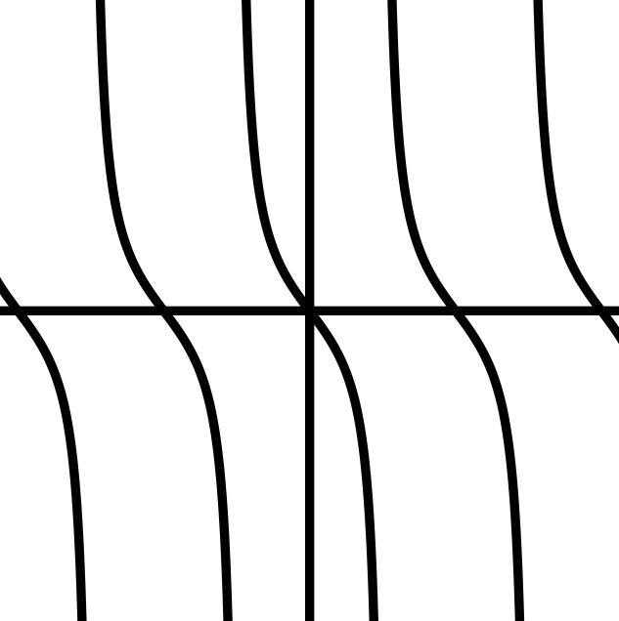


Graphs
$$y=Tan x$$
$$y=−Tan x$$

